Slide 1
Beyond Google: Bibliographic Transformation to Connect Users to Good Content
Regina Romano Reynolds
U.S. ISSN Center
Library of Congress
North Carolina Serials Conference 2017

Slide 2
The Telegraph 1 March 2016 based on research article in Frontiers of Neuroscience

Slide 3
Are we there yet?
Even then…

Slide 7
Must be identified
Must have metadata that is findable on the Web
Must be accessible to users
Good
Content

Slide 8
Evaluate vs. Catalog?

Slide 9
How can we do more, better?
“Bionic” machine-assisted cataloging (AI)
Crowd-sourcing
Batch processing
Use/adapt existing metadata
Re-assess standards, rules, practices
Research,
experiment!

Slide 10
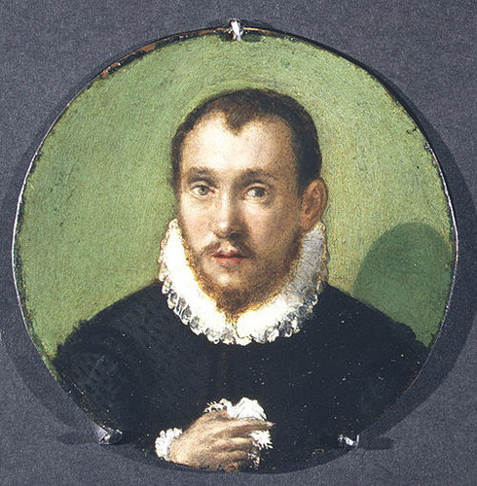
«Il meglio è nemico del bene» The perfect is the enemy of the good!
Notes:
In much of what follows, it is all too easy to say, BUT… we cannot get the same high quality results as we do now… but think: do we need that perfection??

Slide 12
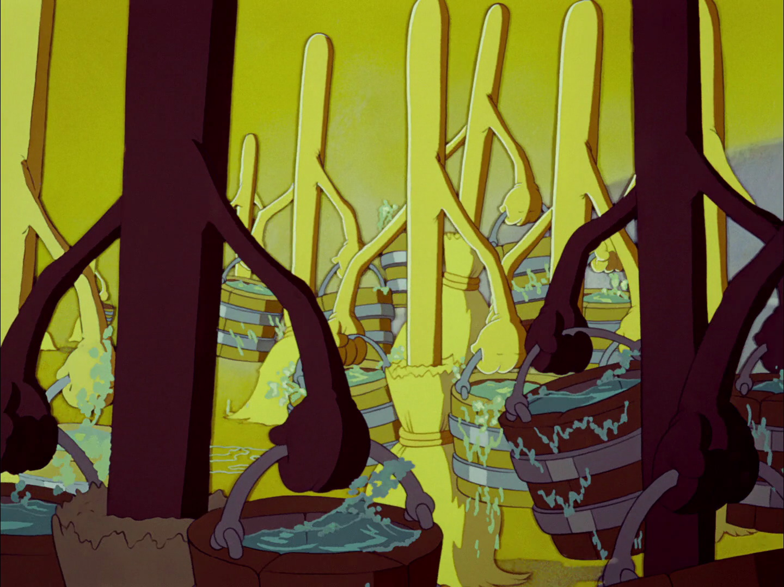
Can today’s cataloging scale?
Hand-crafted cataloging does not scale
Libraries are cutting back on cataloging operations
As currently performed, cataloging requires intensive training, immersive practice
Notes:
Italian staying popularized by Voltaire

Slide 13
Artificial Intelligence

Slide 16
Expert Systems
1980’s experiments produced no accurate results
Problems were found with logic structure and organization of the rules
Difficulty with optical reading of bibliographic elements in print documents caused inaccuracies
“Pebbles for the Mosaic of Cataloging Expertise: What Do Problems in Expert Systems for Cataloging Reveal about Cataloging Expertise?” Alenka Šauperl, Jerry D. Saye

Slide 17
Let’s take a fresh look!
RDA being re-vamped to become more logical
Growing number of resources are in digital form
Some include tagged data

Slide 19
LC on Flickr

Slide 20
LC Flickr Project—user tagging
In the first 10 months (2008)
67,176 tags were added by 2,518 unique Flickr accounts.
4,548 of the 4,615 photos have at least one community-provided tag.
Less than 25 instances of user-generated content were removed as inappropriate.
• More than 500 Prints and Photographs Online Catalog (PPOC) records have been enhanced with new information provided by the Flickr Community.

Slide 21
FAST

Slide 22
FAST

Slide 23
Tips for Crowdsourcing
Andro, M., Saleh, I. (2017). "Digital Libraries and Crowdsourcing: A Review". pp. 135-162. In Collective Intelligence and Digital Archives: Towards Knowledge Ecosystems. Edited by Samuel Szoniecky and Nasreddine Bouhaï, Wiley / ISTE. ISBN 9781786300607. 260 p.

Slide 24
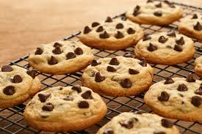
Who bakes cookies one at a time?

Slide 26
Getting others to do the work for us: Re-purposing existing metadata

Slide 27
Goal: 30,000+ ISSN!

Slide 28
10,737+ ISSN assigned

Slide 29
?

Slide 30
Publisher-supplied Metadata

Slide 33
Under development

Slide 34
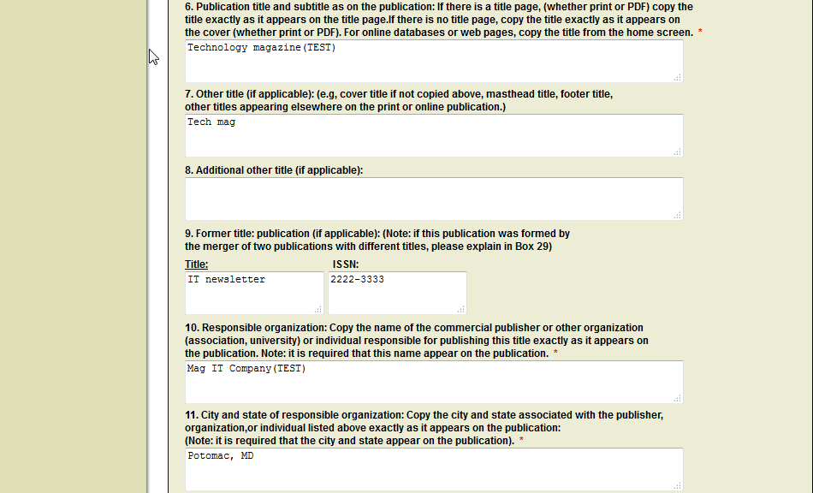

Slide 35
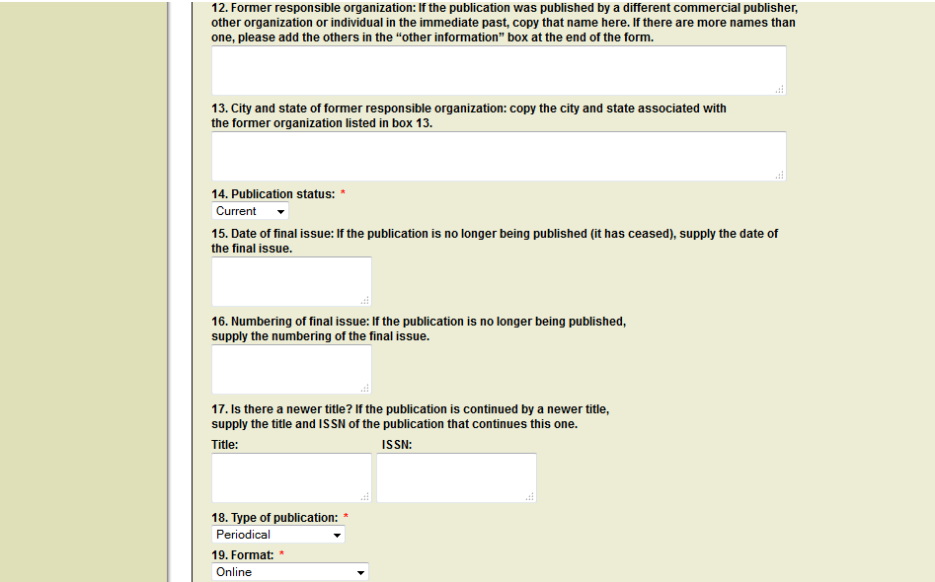

Slide 36
Application + converted record

Slide 38
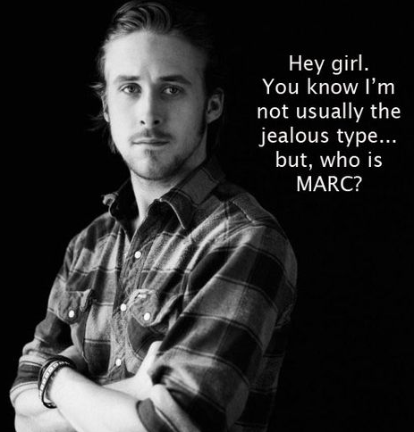
Keep assessing rules, standards, practices

Slide 39
A few thoughts…
Could we catalog only at the work level?
Exploit RDA’s emphasis on elements rather than records
Focus efforts on unique items and library value-added elements: subjects, names
Do we need to laboriously transcribe title pages of resources that are only an online click away?

Slide 40
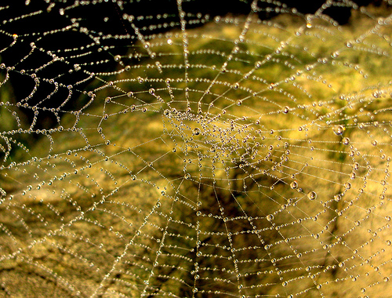
Whither Serials Cataloging?
IFLA LRM has opened itself to further development by the serials community
ISSN standard under revision
Focus on separable elements and linked data can solve the latest/successive entry conundrum

Slide 42
(Kathy Glennan,
ALA Rep to RSC
May 2016)

Slide 46
More than a new format-- a new bibliographic environment

Slide 47
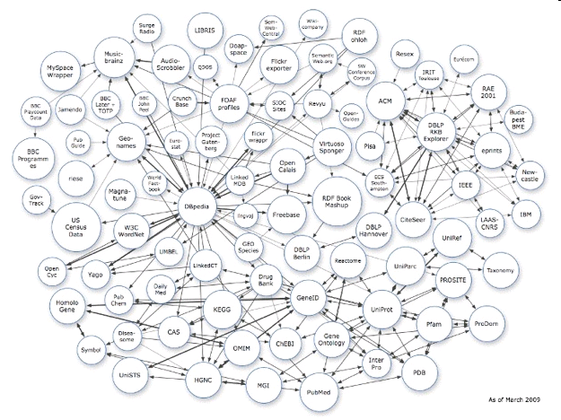
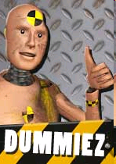
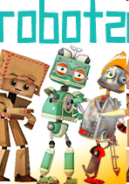
Who subscribes
Author
registries
Journals
Costs?
Where
Archived
subscribe
Former and later titles
Notes:
Future semantic web, possibilities for use of ISSN
47

Slide 48
Can linked data’s focus on elements, not records, help solve a problem that continues to haunt serials?

Slide 49
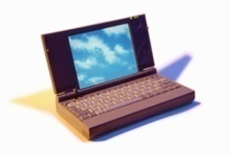
Title A
1950-1960
ISSN-L 1234-5678
print ISSN
CD-ROM ISSN
online ISSN
Continued by
Title B
1961-1970
ISSN-L 7654-321X
print ISSN
online ISSN

Slide 50
Revising the ISSN Standard:
How do you update
an icon?

Slide 51
Notes:
This might seem obvious and trivial to state, but as those trying to develop new identifier standards know, it is no small thing. The standard itself, plus the time, money, and energy to maintain it or be involved in its maintenance. Review every 5 years. Even if revision does not take place that often, when it does, several years, many meetings, much time is needed. I will discuss status of the current revision at the end of my presentation.

Slide 52
Potential Revision Topics
Create an ISSN for serial “families”
Determine ISSN policy for digital “editions”
Assign separate ISSN to formats such as PDF, HTML, ePub?
Align ISSN mandatory metadata with ONIX and other standards?
Content identification vs. product identification?
Equip ISSN to function in a linked data environment

Slide 53
ISSN-F ?

Slide 54
Digital Formats/Editions: Separate ISSN?
PDF
HTML
Epub
Android
Kindle
Etc., Etc.
Born digital edition
Digitized print edition
Modified for Android
Etc., etc.
Note: The ISBN standard now requires separate ISBN
for the various digital formats

Slide 55
What else can we do to ensure we connect our users with good content?

Slide 56
Research!
Experiment!

Slide 57
SOS!!

Slide 58
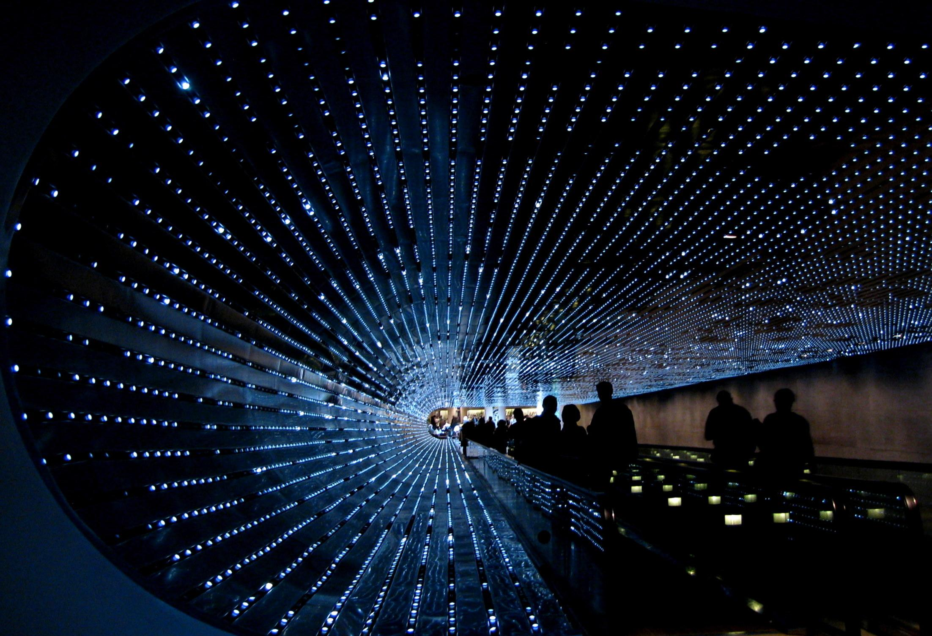
The future is closer than we think!
© RRReynolds

Slide 59
Revolution not Evolution?
Reynolds
59
Notes:
59
There is a lot of evolution going on but I worry that we might need a revolution instead: as when MARC, OCLC, ISSN, all burst on the library scene in the late 60’s I was amazed to read that Henriette Avram, a computer programmer not versed in libraries or cataloging, was hired at LC in 1965, began the MARC pilot began 1966 , and it went was operational in 1969. OCLC was founded in 1967 and first library record was input 1971. We need to quick and dramatic changes to keep up with the rapid pace of change in the information landscape.

Slide 60
Where do you think the perfect is the enemy of the good in libraries?
What else can we do to connect users to good content?

Slide 61
If we don’t know where we want to go, how will we know when we have arrived?
© RRReynolds
Notes:
I know I have thrown out a lot of ideas but I believe that we have to first envision or future…

Slide 62
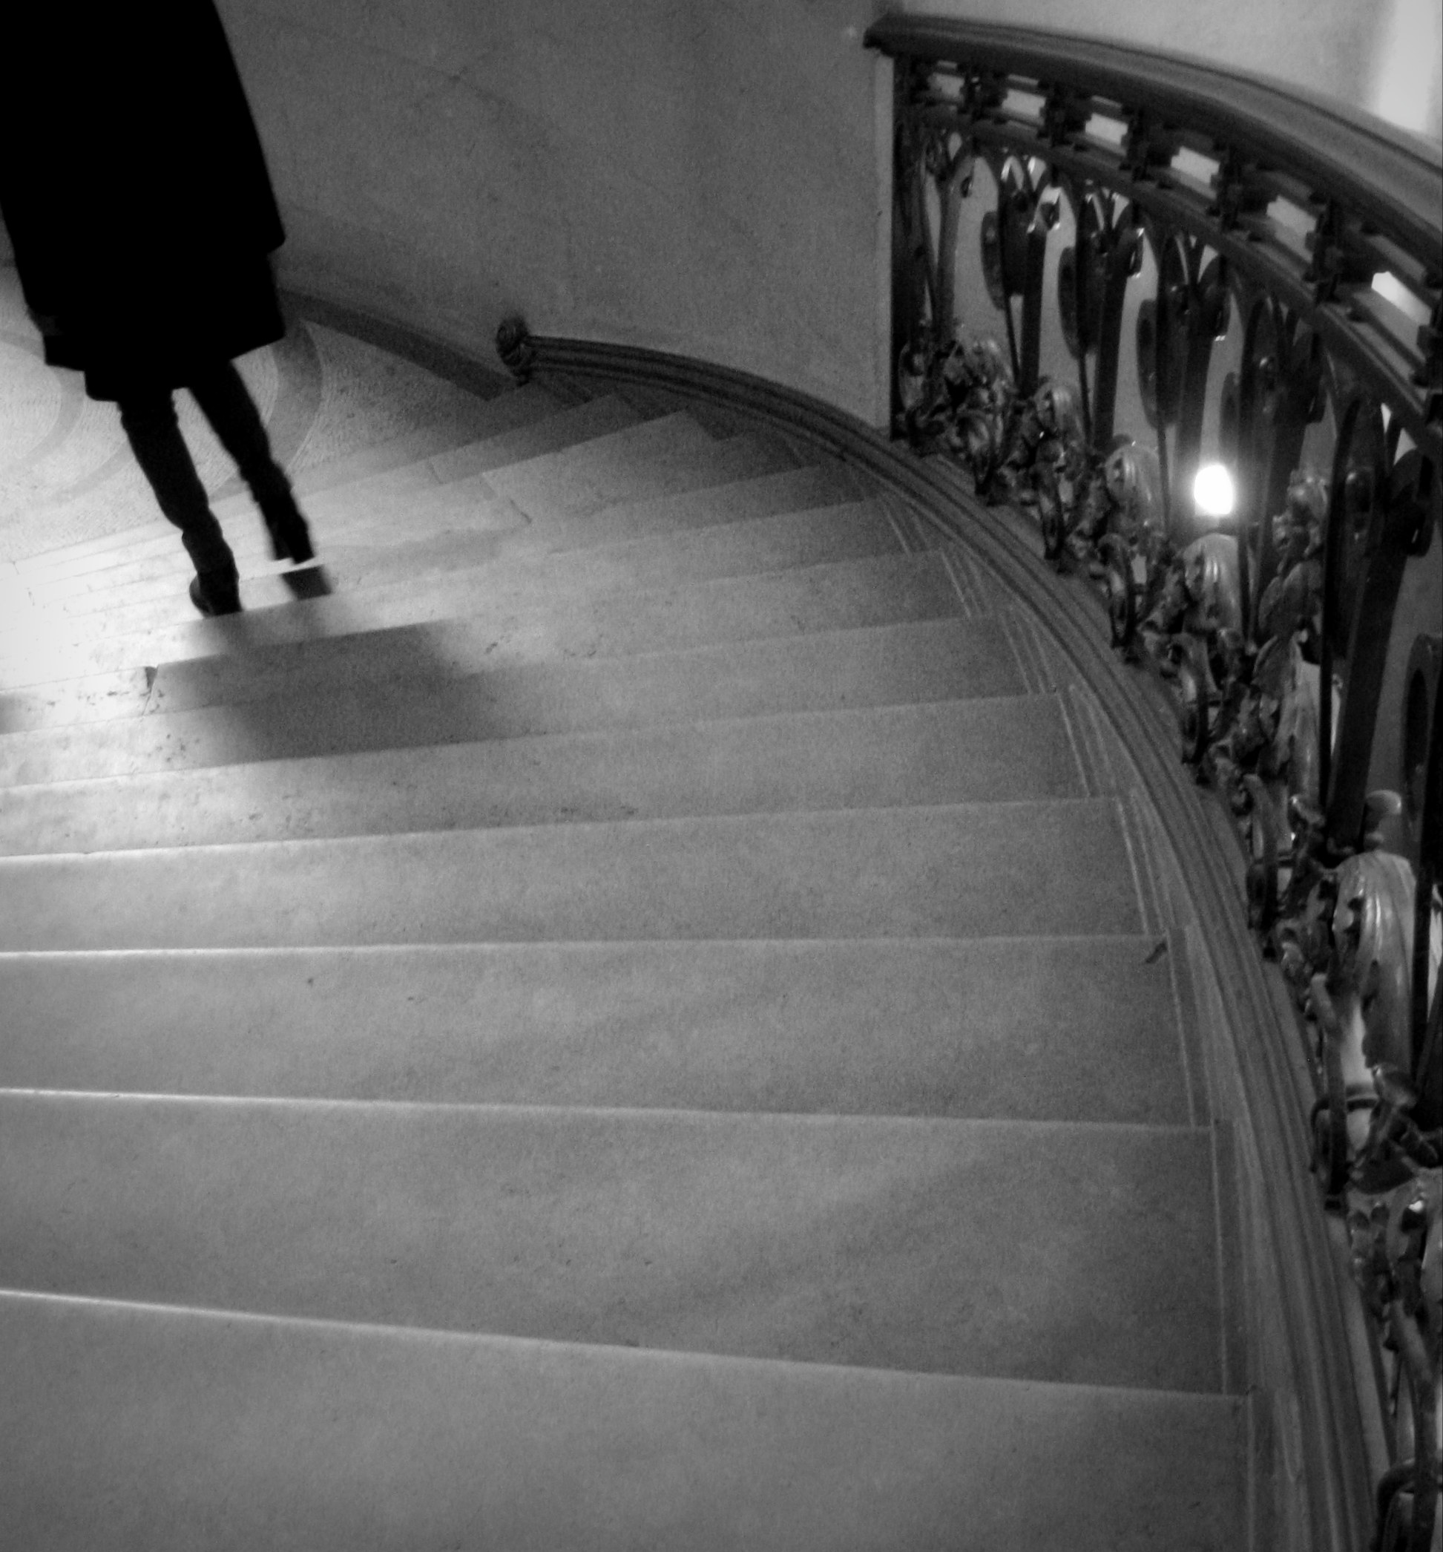
Thank you!
rrey@loc.gov
Reynolds

